Slide 1
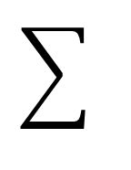
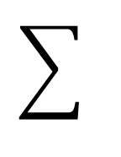
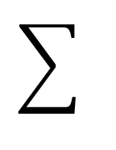
z = 'GCTACGGCCGCGCATTCGATCGCGATTCGTTTG'
(L) | A | C | G | T
A | -56.85 | -0.20 | -56.85 | 0.82
C | 1.72 | -58.06 | 2.74 | -58.79
G | 58.79 | 0.00 | 0.00 | -1.00
T | 0.25 | -0.14 | 0.00 | -0.39
= 1.75
(a)
z = 'GCTACGGCCGCGCATTCGATCGCGATTCGTTTG'
(L) | A | C | G | T
A | -56.85 | -0.20 | -56.85 | 0.82
C | 1.72 | -58.06 | 2.74 | -58.79
G | 58.79 | 0.00 | 0.00 | -1.00
T | 0.25 | -0.14 | 0.00 | -0.39
= 1.75
(b)
z = 'GCTACGGCCGCGCATTCGATCGCGATTCGTTTG'
(L) | A | C | G | T
A | -56.85 | -0.20 | -56.85 | 0.82
C | 1.72 | -58.06 | 2.74 | -58.79
G | 58.79 | 0.00 | 0.00 | -1.00
T | 0.25 | -0.14 | 0.00 | -0.39
= 3.30
(c)

Slide 2
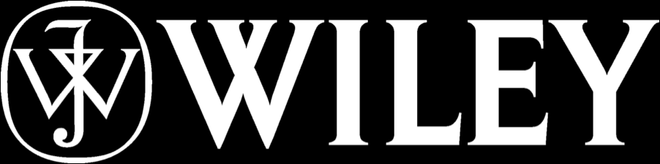

Local score computation by using the LLM
Local score computation by using the LLM. (a-c) The three panels show the first steps in the scanning process. A sliding window slides above the z-sequence with a step of 1. In any of the three panels (a-c), the ladders indicate the successive transitions over the sliding window. The rows and columns in the LLM have the same meaning as in a transition matrix, namely the rows indicate the current state (the first letter in the combination) and the columns indicate the state to which the transition is made (the second letter in the combination). The value in the element at the intersection of the two positions is the log liklehod ratio value added to the summation. The sum sign indicates that the log likelihood ratio values corresponding to each transition are summed together to compute the local score of the sliding window content.
Cite this work as:
Paul A. Gagniuc. Algorithms in Bioinformatics: Theory and Implementation. John Wiley & Sons, Hoboken, NJ, USA, 2021, ISBN: 9781119697961.

